Slide 1
Catapult GUI System
Rayyan Khan
7/3/2024

Slide 2
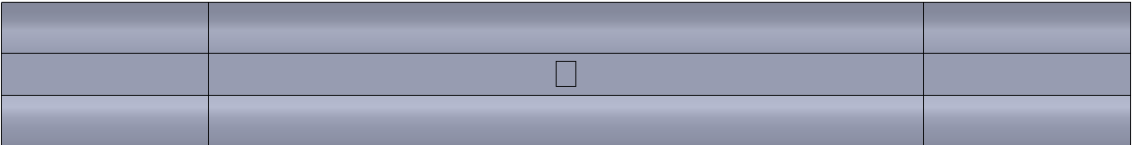
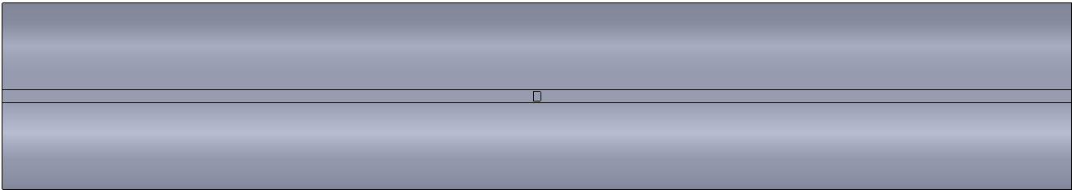
Problem Formulation
Twist Length
For the GRC shaft and MTS bar a fixed constraint is applied at one end (at the center of the grip region) and a twist (in degrees) is applied at the center of the grip region at the opposite end.
For the large shaft, the fixed constraint and twist are applied at the end cross-sections.
For the GRC Shaft & MTS Bar: Twist Length = Total length – 2*(1/2 * Grip Length)
=> for the MTS bar: Twist length = 12” – 2*(1/2* 1”) = 11”
=> for the GRC shaft: Twist length = 15” – 2*(1/2* 2.75”) = 12.25”
For the Large shaft: Twist length = shaft length = 1000mm (39.37”)
Twist/inch = Applied Twist/Twist Length
The surface shear strain and Von Mises Stress are computed in the SAW imprint region.
GRC Shaft
Grip Region
SAW imprint (8.443 mm x 6.637mm)
Twist Length
MTS Bar
Twist Length = Shaft Length
Large Shaft

Slide 3
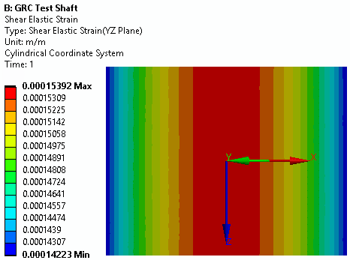
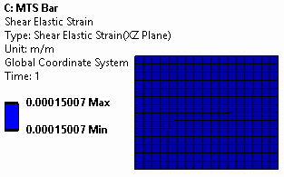
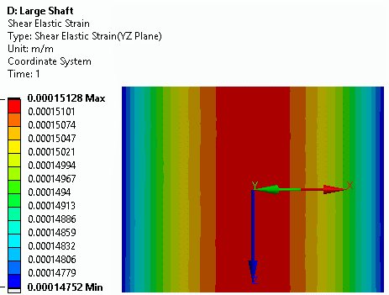
Results
 | 350 µe
# | Test Specimen | Torque (N-m) | Twist (deg/in) |  | VM Stress (MPa)
1 | GRC Test Shaft 2" dia w/ 4 flats | 600 | 0.0147 |  | 46.9
2 | MTS Bar (1" x 12" x 1/8") | 2.12 | 0.147 |  | 46.63
3 | Large Dia Shaft | 8405 | 0.00558 |  | 46.65
 | 250 µe
# | Test Specimen | Torque (N-m) | Twist (deg/in) | VM Stress (MPa) | VM Stress (MPa)
1 | GRC Test Shaft 2" dia w/ 4 flats | 429 | 0.0105 | 33.5 | 33.5
2 | MTS Bar (1" x 12" x 1/8") | 1.51 | 0.105 | 33.31 | 33.31
3 | Large Dia Shaft | 6003 | 0.00398 | 33.32 | 33.32
 | 150 µe
# | Test Specimen | Torque (N-m) | Twist (deg/in) |  | VM Stress (MPa)
1 | GRC Test Shaft 2" dia w/ 4 flats | 257 | 0.00630 |  | 20.1
2 | MTS Bar (1" x 12" x 1/8") | 0.91 | 0.0630 |  | 19.985
3 | Large Dia Shaft | 3602 | 0.00239 |  | 19.994
Note: MTS bar has a uniform shear strain in the SAW imprint region

Slide 4
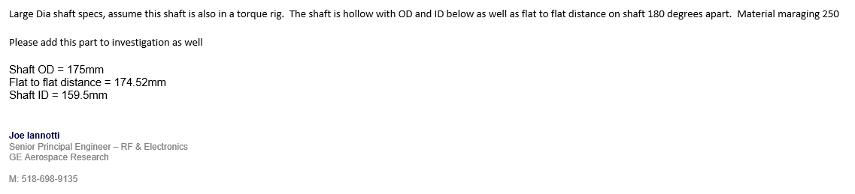

Slide 5

To learn more, please visit www.endeavos.com
© Endeavos Innovations Inc. All Rights Reserved 2020

